Slide 1
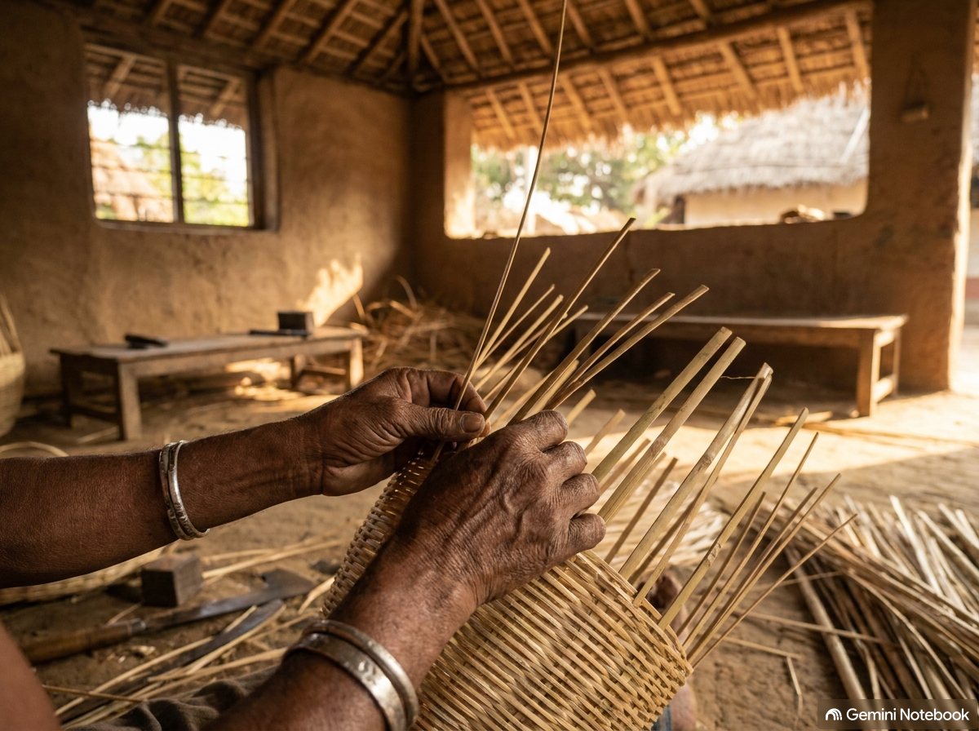
Team
Renaissance Guild
IDEA TITLE
KARIGAR SETHU
SMART INDIA
HACKATHON 2026
KarigarSetu
Voice-First Market Linkage for Marginalized Artisans
✦ Problem Statement ID — SIH26090
✦ Problem Statement Title — AI-Driven Market Linkage and Smart Cataloging Mobile Application for Marginalized Artisans
✦ Theme — Heritage and Culture
✦ PS Category — Software / Hardware
✦ Team Name — Renaissance Guild
✦ Empowering rural weavers and makers by converting regional spoken dialects directly into professional, global market-ready catalogues.
Smart India Hackathon 2026 — Team Renaissance Guil
@SIH Idea submission- Template
Slide 1 / 6

Slide 2
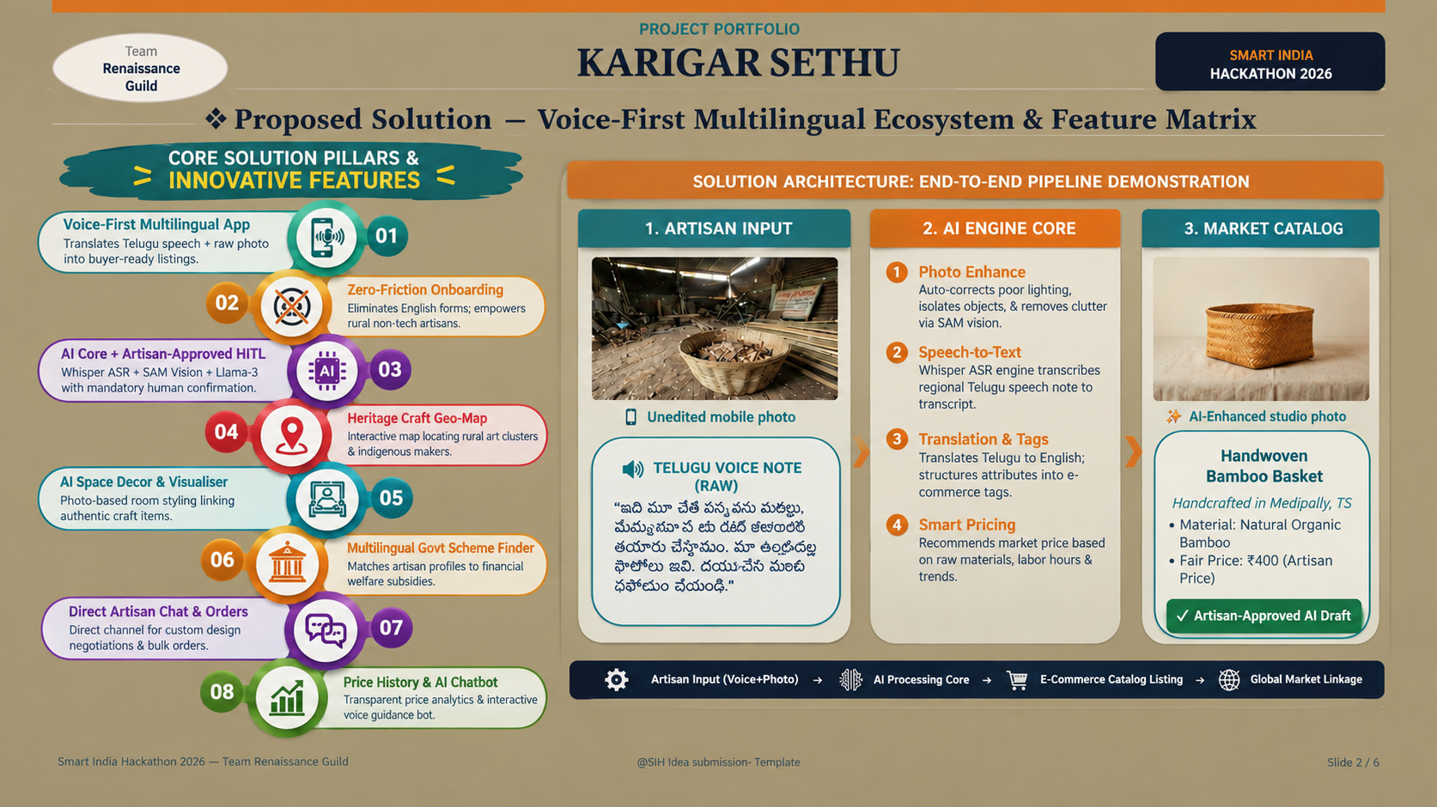

Slide 3
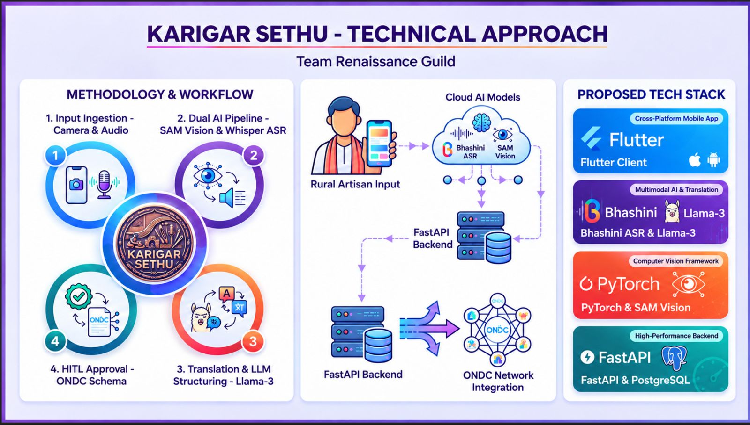

Slide 4
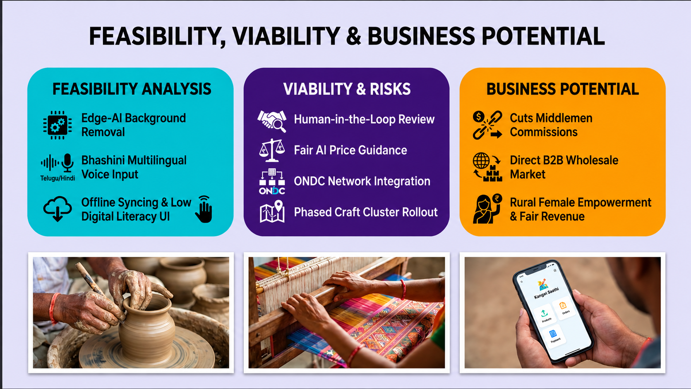

Slide 5
Team
Renaissance Guild
IDEA TITLE
KARIGAR SETHU
SMART INDIA
HACKATHON 2026
❖ Impact & Benefits
FOR MARGINALIZED ARTISANS
SEAMLESS PRODUCT JOURNEY
FOR BUYERS & ECOSYSTEMS
• Professional Digital Cataloguing: Creates a stunning, standardized digital product listing directly from a raw smartphone photo and regional voice inputs.
• Complete Language Inclusion: Reduces critical dependency on English writing, advanced computer literacy, and expensive professional agency services.
• Less Onboarding Effort & Friction: Enables wider buyer discovery. Eliminates physical-only sales limitations at local fairs and seasonal exhibitions.
• Total Control & Full Agency: Keeps artisans firmly in control. AI-generated product descriptions stay fully editable and require confirmation before publishing.
• Seamless Buyer Discovery: Provides large-scale B2B bulk buyers, boutique retail partners, and export agents with clearer, standardized product sheets.
• Standardised Product Metadata: Supports state cooperatives, craft societies, and NGOs with clean, structured, and searchable catalogs of local artisan outputs.
• Stronger Institutional Market Linkages: Bridges physical-to-digital gaps, allowing marginalized creators to directly service corporate gifting channels and large buyer networks.
• ONDC-Ready Pathway Layout: Structures inventory output data directly into schema-ready formats to facilitate future frictionless integration on open commerce.
1. Artisan Input
Raw Photo + Telugu Voice Note
v
2. AI Engine Draft
ASR Transcription & Listing Generation
v
3. Artisan Verification
Review, Edit, and Tap to Approve
v
4. Buyer-Ready Catalog
Live Listing matching with Bulk Buyers
HOW WE WILL MEASURE PILOT IMPACT (Measurable Success Metrics)
TIME SAVED
Drafting Speed
Catalogue creation cut from days to under 2 mins per item
LISTINGS APPROVED
Artisan Approval
Number of voice-drafted listings reviewed & confirmed
BUYER ENQUIRIES
Market Matching
B2B bulk leads and matches made via regional database
INDEPENDENT USE
Self-Sufficiency
% of rural artisans completing listings with zero tech aid
Smart India Hackathon 2026 — Team Renaissance Guild
@SIH Idea submission- Template
Slide 5 / 6

Slide 6
Team
Renaissance Guild
IDEA TITLE
KARIGAR SETHU
SMART INDIA
HACKATHON 2026
❖ Research & References
Official sources and statutory structures that informed KarigarSetu's design and digital-market linkage strategy
IndiaHandmade
Ministry of Textiles, Government of India. Official e-marketplace created to support weavers and artisans by enabling direct customer sales.
mindiahandmade.com
BHASHINI
Digital India Initiative • MeiTY. Translates and transcribes regional audio, breaking critical language barriers for voice-led listings.
bhashini.gov.in
ONDC (Open Network)
DPIIT, Government of India. Provides a unified, open framework for digital-commerce discovery and frictionless localized merchant access.
ondc.org
DC (Handicrafts)
Ministry of Textiles. Nodal government body directing nation-wide handicraft clusters, artisan welfare, and design training development.
handicrafts.nic.in
Indian Handicrafts Portal
Development Commissioner (Handicrafts). Centralized portal for registering artisan identity, checking schemes, and tracking regional crafts.
indian.handicrafts.gov.in
Amazon Karigar
Amazon India Initiative. Supports Indian artisans and small businesses by providing access to online markets, helping them showcase and sell traditional handmade products to customers nationwide
Amazonkarigar.com.
✦ All AI-generated catalogue details remain editable and artisan-approved before publishing — ensuring accuracy, ownership, and trust.
Smart India Hackathon 2026 — Team Renaissance Guild
@SIH Idea submission- Template
Slide 6 / 6

